Slide 1
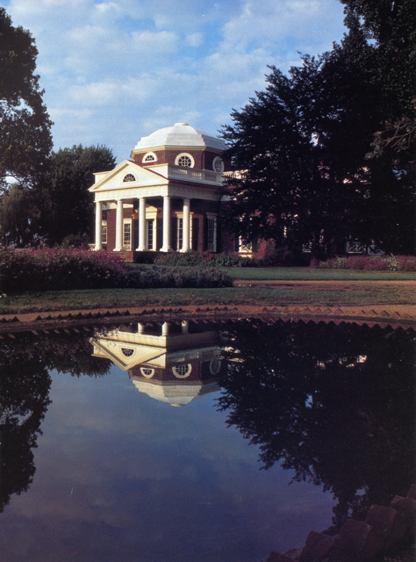
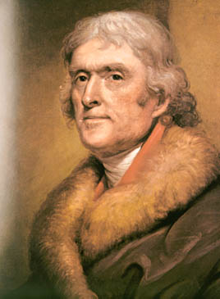
Ch. 11The Jeffersonian Era

Slide 2
Democratic- Republican Party
1st 2-party system: Federalists vs. Democratic-Republicans
Sometimes called the Republicans (don’t confuse with modern Republicans)
Organized by Thomas Jefferson and James Madison
Guardians of agrarian purity, liberty, and states’ rights
States' rights (KT and VA Resolutions)
Vision = An agrarian (agricultural) and commercial economy
Strict construction
Friendship with France

Slide 3
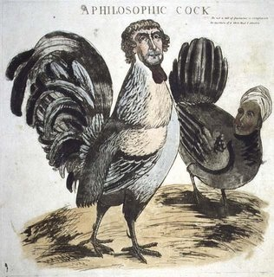
Election of 1800
1
8
0
0
Federalist propaganda:
a thief, a coward, and “a mean-spirited, low-lived fellow, the son of a half-breed Indian squaw, sired by a Virginia mulatto father.”

Slide 4
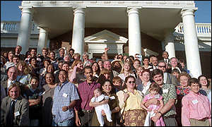
Sally Hemings
The descendants of Sally Hemings at a family reunion (1999)

Slide 5
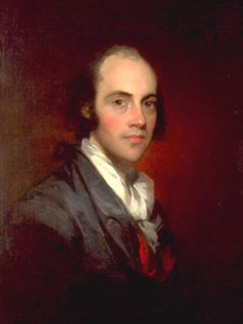
Election Results
1
8
0
0
Both Jefferson and Aaron Burr received 73 votes in the electoral college.
The Constitution required that the House of Representatives, voting by states, choose between them.
Jefferson was elected.
Twelfth Amendment

Slide 6
“Revolution” (?) of 1800
What Changed:
What Didn’t Change:
No fanfare at inauguration
Informal White House
Non-hierarchical seating at official dinners
Sends messages to Congress
Pardons “martyrs” of Alien & Sedition Acts
Naturalization law of 1802
1st inaugural address: “We are all Republicans…”
Patronage - “few die, none resign”
Funding of debt, bank, protective tariff
Allows excise tax, Alien & Sedition Acts to expire

Slide 7
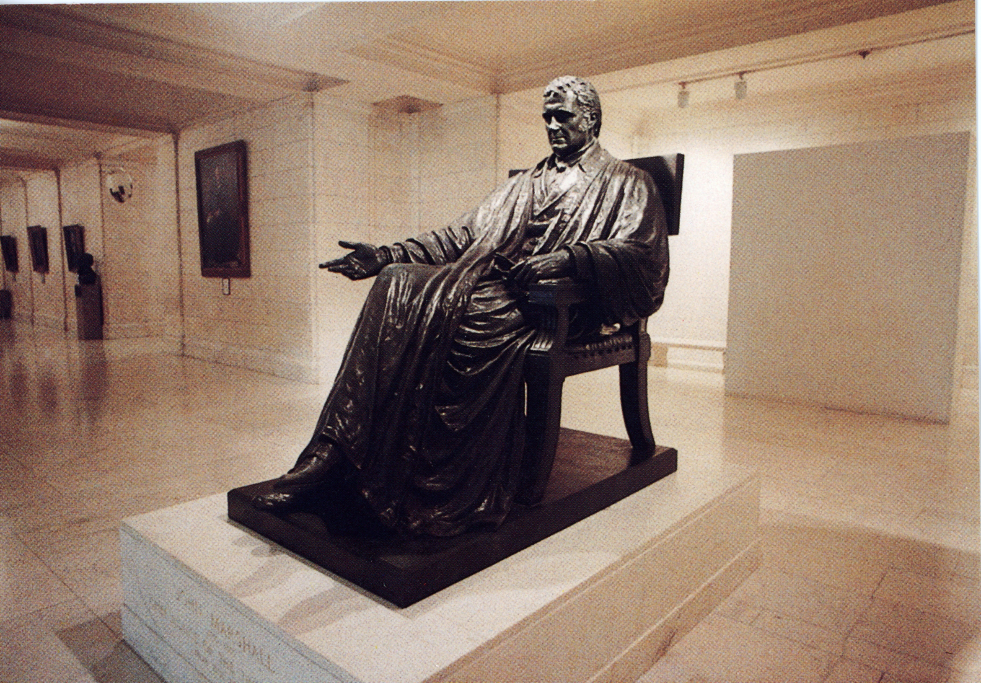
John Marshall
1
8
0
1
Chief justice of the United States from 1801 to 1835.
A Federalist
His court issued several significant decisions including those in Marbury v. Madison and McCulloch v. Maryland.
His decisions generally expanded the power of the national government and promoted economic development.
His rulings consistently upheld the sanctity of contracts and the supremacy of federal legislation over the laws of the states.

Slide 8
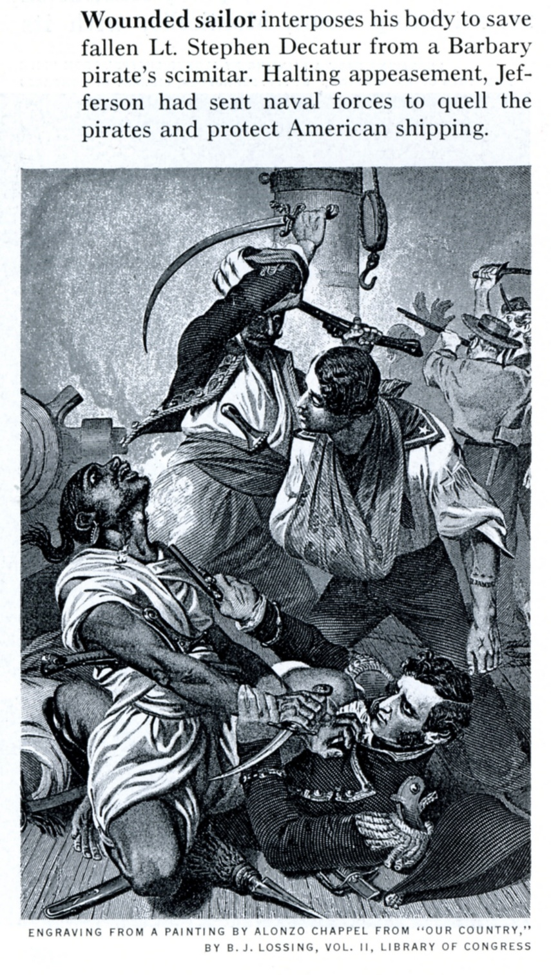
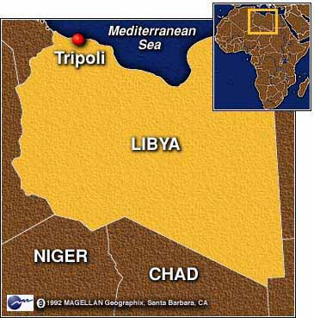
TJ’s Foreign Policy
Reduction of military
“peaceful coercion” – forswearing military force
Barbary pirates (“from the halls of Montezuma to the shores of Tripoli”)

Slide 9
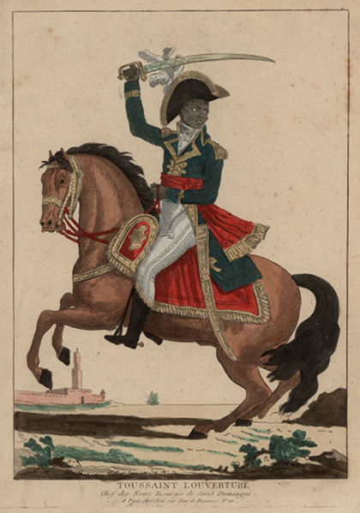
Louisiana Purchase
1
8
0
3
French control of New Orleans and Mississippi
Influenced by slave revolt in Santo Domingo (Toussaint L’Ouverture)
Napoleon Bonaparte decides to focus on Europe

Slide 10
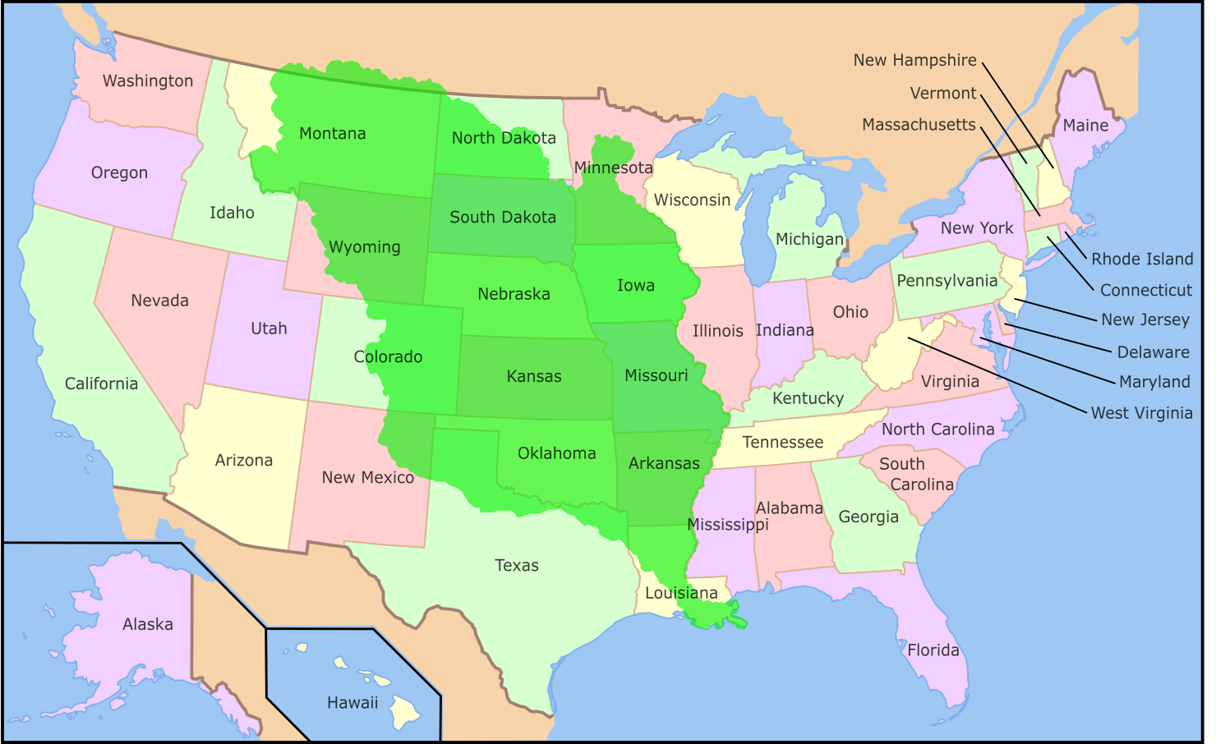
Louisiana Purchase
1
8
0
3
828,000 square miles
$11,250,000 plus cancellation of French debts
Doubles the size of the U. S.

Slide 11
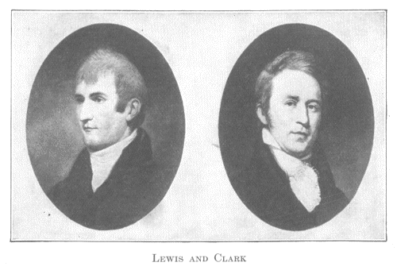
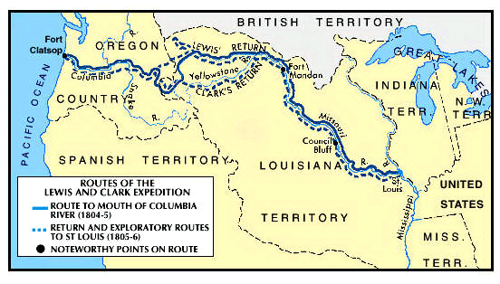
Lewis and Clark
1803
1806
Jefferson commissions Meriwether Lewis and William Clark to explore Louisiana Territory and beyond to the Pacific Coast
Their expedition (1803-1806) brings back wealth of data about the country and its resources

Slide 12
“Empire of Liberty”
Thomas Jefferson’s term
seen as “…guardians of agrarian purity, liberty, and states’ rights.”
Synthesis: time eventually destroys empire
Unending new space in which to expand postpones decline
Land is the great equalizer.
No overpopulation = no class divisions

Slide 13
strict constructionist?
Consider the following:
Does the Constitution specifically give the government the authority to purchase new lands?
Was Jefferson a hypocrite?
Is it possible that the presidency changes people’s perspective?
Is strict construction a valid philosophy?

Slide 14
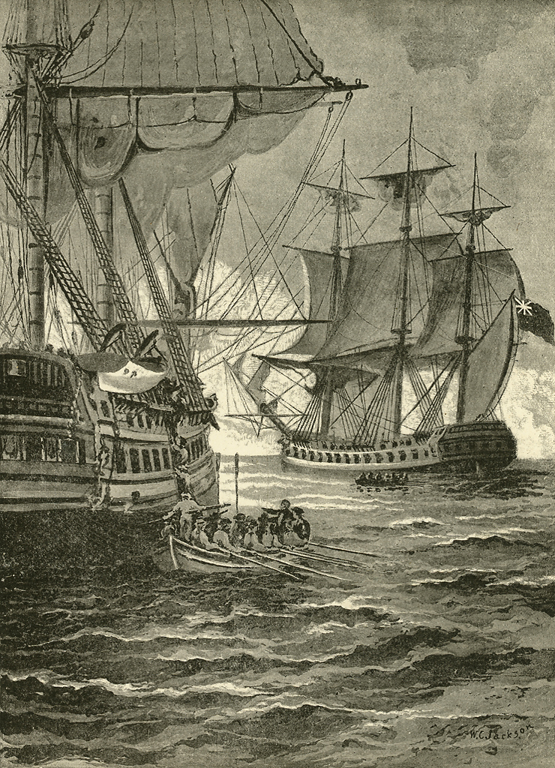
British Orders in Council
1
8
0
7
Series of edicts closing European ports under French control to foreign shipping, including America, unless the vessels first stopped at a British port.
Problem: the orders ignored America's claims to neutral rights (Washington, 1793).

Slide 15
Chesapeake-Leopard Incident
1
8
0
7
The United States naval vessel Chesapeake was fired upon and boarded by British officers from the Leopard, off the coast of VA
Killed 3, wounded 18, and 4 sailors were impressed into service for the Royal Navy.
Result: provoked clamor for war in the US, but President Jefferson asked Congress for the Embargo Act instead.
impressment

Slide 16
Embargo Act of 1807
1
8
0
7
Provoked by the "Chesapeake" incident.
Prohibited all exports from American ports.
Jefferson hoped to pressure Britain and France into recognizing “neutral rights.”
Underestimated determination of Britain, NOT their reliance on American trade.
Britain produces a “bumper grain crop.”
Latin American ports open up for commerce.
Embargo damaged the U.S. economy instead and was bitterly resented, especially in New England.
Difficult to enforce – leads to smuggling, again!
“peaceful coercion”

Slide 17
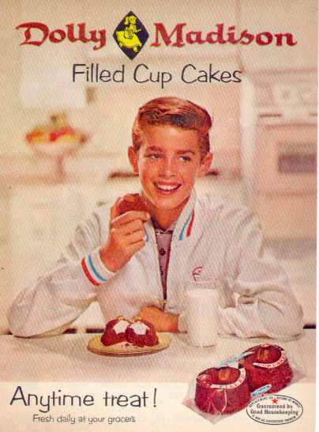
James Madison
1
8
0
9
Author of the Virginia Plan
“Father of the Constitution”
Compiler of the Bill of Rights
Author of the Virginia Resolution
Fourth POTUS
Husband of Dolly Madison
“Cakes fine enough to eat at the White House.”

Slide 18
Non-Intercourse Act
1
8
0
9
In 1809, three days before Jefferson’s term ends, Congress replaced the Embargo Act with the Non-Intercourse Act.
It forbade American trade only with Britain and France
It authorized the president to end non-intercourse with either nation if it stopped violating America's neutral rights.
“peaceful coercion”

Slide 19
Macon’s Bill No. 2
1
8
0
9
Replaced the ineffective Non-Intercourse Act.
Removed all restrictions on commerce with France and Britain, but it authorized the president to reapply non-intercourse to either power if one of them violated American neutral rights.
Problem: proves we need either Britain or France to survive economically.
Madison accepts Napoleon’s offer, gives Britain 3 months to agree – they do NOT!
“peaceful coercion”

Slide 20
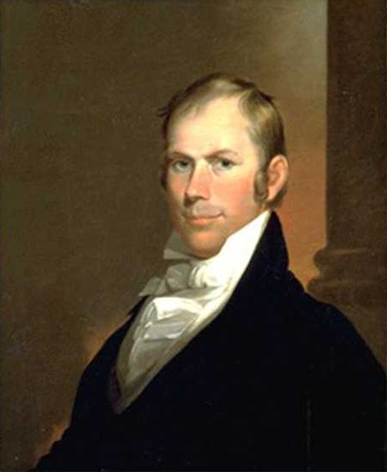
War Hawks
1
8
1
1
Speaker of the House, Henry Clay
Young congressional leaders from South and West
Called for war against Great Britain in 1811 and 1812
Tired of Jefferson and Madison’s “peaceful coercion”
Saw war as the only way to defend the national honor and force the British to respect America's neutral rights.
“hawks and doves”

